Slide 1
Introduction to Machine Learning
Nishant M Gandhi

Slide 2
Content
Introduction to AI
Data Science vs Data Engineers vs Data Analyst
Machine Learning Project Lifecycle
Supervised Learning
Underfitting vs Overfitting
Introduction to Unsupervised Learning
Introduction to Reinforcement Learning

Slide 3
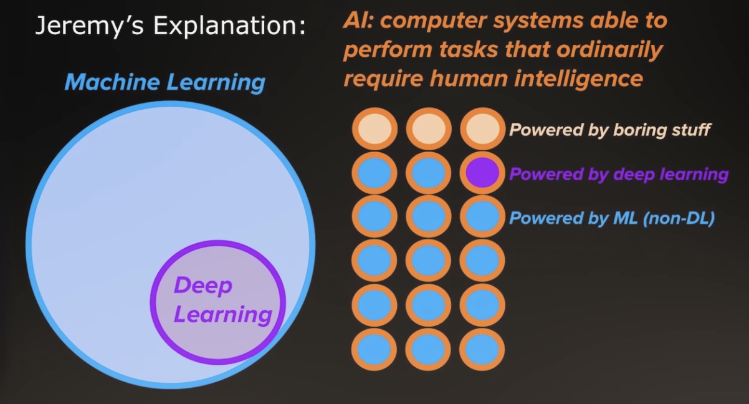
Introduction to AI:
What is AI?
The system that can perform
a task which requires human intelligence in general.

Slide 4
Whatever you are studying right now if you are not getting up to speed on deep learning, neural networks, etc., you lose.
Mark Cuban

Slide 5
It is difficult to think of a major industry that AI will not transform.
Andrew NG

Slide 6
The nation that leads in AI ‘will be the ruler of the world’
Vladimir Putin

Slide 7
Applications of AI:
Predictive Modeling Analytics
Opposite of Descriptive analytics
Natural Language Processing
Speech, Video, Image Processing
Recommendation Engine
Clustering
And more...

Slide 8
Machine Learning Model:
A model can be thought of as a statistical assumption (or set of statistical assumptions) with a certain property: that the assumption allows us to calculate the probability of any event.

Slide 9
Learning Category:
Supervisor Learning
Linear: model that is represented by generating linear equation
Tree: model that is represented by building decision tree
Probabilistic model: model that is represented by probability equation
Neural Network: model that is represented by Neural
Support Vector Machine: model that try to find linear equation
Unsupervised Learning
Finding pattern and build clusters
Semi-supervised Learning
Reinforcement Learning
Learn by optimizing objective function

Slide 10
Supervised Learning Problems:
Regression Problem
A regression problem is when the output variable is a real or continuous value, such as “salary” or “weight”.
Classification Problem
A classification problem is when the output variable is a binary category, such as “red” or “blue” or “disease” and “no disease”
Multiclass-classification Problem
A classification problem is when the output variable is a category in multiple class, such as “Type of Discounts” or “Category of Disease”
Time-Series Problem
A time series forecasting problem in which you want to predict one or more future numerical values is a regression type predictive modeling problem.

Slide 11
Dependant and Independent Variable:
Independent variables are controlled inputs. Dependent variables represent the output or outcome resulting from altering these inputs.
Example:
Outlook | Temperature | Humidity | Windy | Decision
Sunny | 25 | 85 | weak | play
Rain | 15 | 90 | strong | Don’t play
….

Slide 12
Data Types:
Numeric
Continuous: Infinite (weight)
Discrete: Finite (age)
Categorical
Ordinal: Has hierarchy (Low, Medium, High)
Nominal: Has no hierarchy (Male, Female)

Slide 13
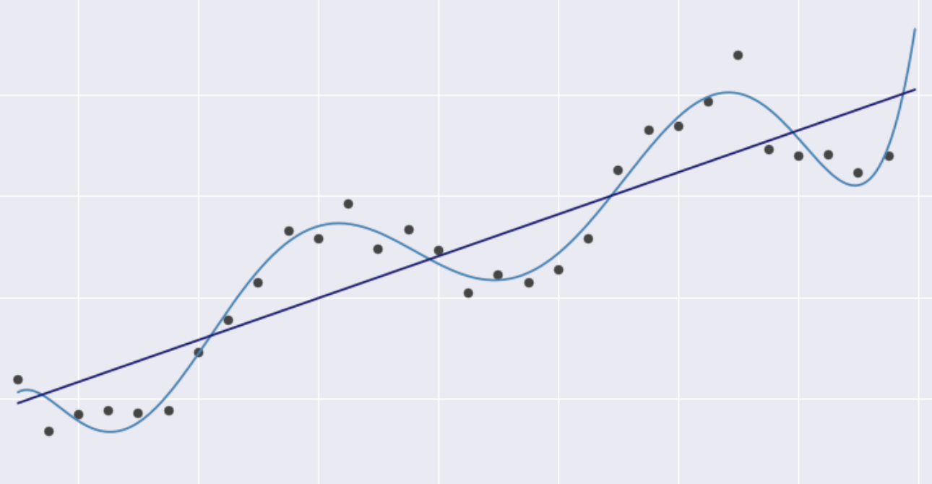
Linear Model:
Find the coefficients: a, b, c,...
Y = ax + bx^2 + cx^3 + .....

Slide 14
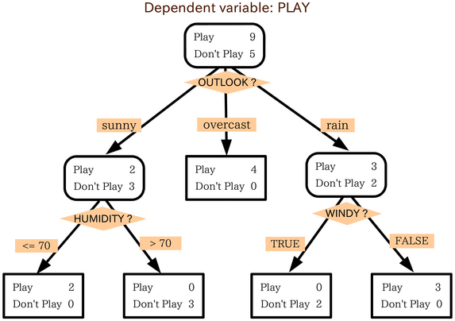
Tree Based Model:
Create the tree and set probability for each branch decision.

Slide 15
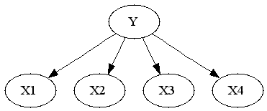
Probabilistic Model:
Naive Bayes Classifier

Slide 16
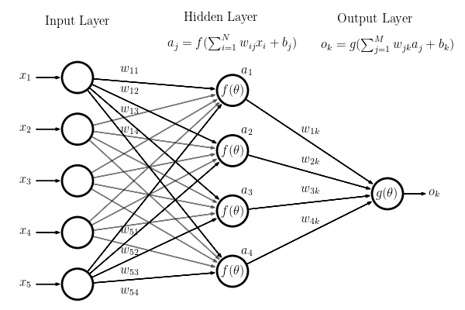
Neural Network:

Slide 17
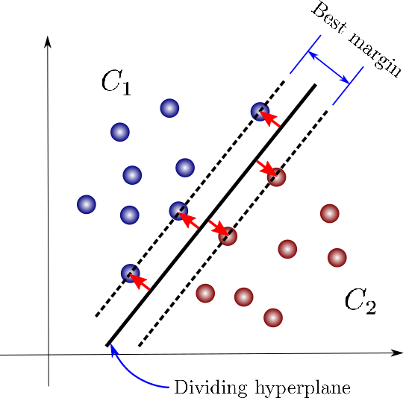
Support Vector Machine:
Find hyper plane with best margin and lease error.

Slide 18
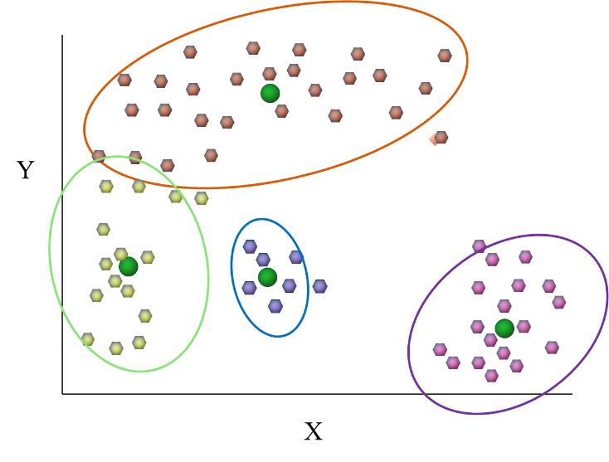
Unsupervised Learning:
Most Common Usecase:
Clustering Analysis

Slide 19
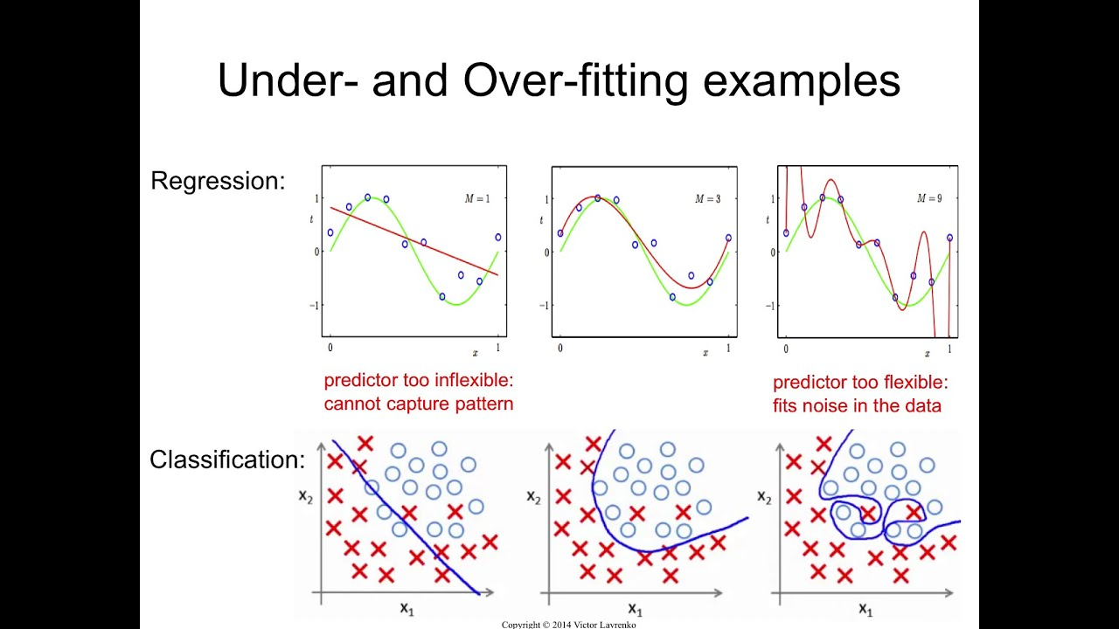
Underfitting vs Overfitting

Slide 20
Machine Learning Project Life Cycle:
Collect Data
Build Model
Validation
Deploy & Maintain

Slide 21
Example:
Presentation of Group Project

Slide 22
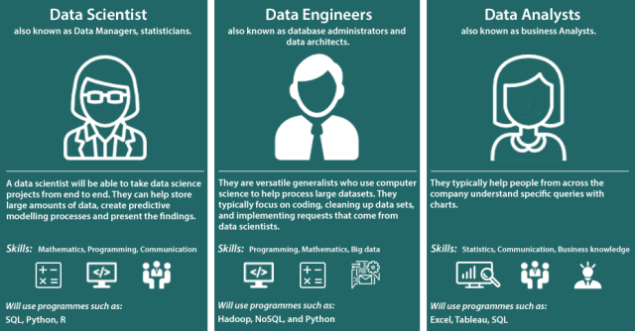
Data Science vs Data Engineers vs Data Analyst

